Slide 1

 | Kebijakan (policy) | Doc. No :
 | SEAM SEALING STANDARD PROCEDURE | Page | 01 of 15
 |  | Date of making | 02 Desember 2022
 |  | Date of revise
 |  | Revise No.
Tugas Kerja QC Tes Air & Materi
( jenis-jenis bocor, macam – macam defect bocor, nama - nama body di tes air )

Slide 2

Waterproof Test Standard ( Standar Tes Air )
Waterproof Test Machine ( Mesin Tes Air )
ARC’TERYX Waterproof Test Form ( Laporan Tes Air ARC’TERTX )
Steps To Do By The Waterproof Test QC If There Is Leaking ( Langkah – Langkah Yang Harus Dilakukan Oleh QC Tes Air Bila Terjadi Bocor )
Kinds of Leakage ( Jenis – Jenis Bocor )
Name of Body Parts in Garment For Waterproof Test ( Nama – Nama Bagian Body Untuk Tes Air )
CONTENTS

Slide 3
Waterproof Test Standard ( Standar Tes Air )
Waterproof Test Checking Time Standard ( Standar Waktu Pengecekan Tes Air )
  2 minutes for tape gore-tex & storm. ( 2 menit untuk tape gore-tex & storm )
  1 minute for gore-tex & light rain, future light tape. ( 1 menit untuk tape gore-tex & light rain, future light )
Pressure Waterproof Test Standard ( Standar Tekanan Test Air )
  3 PSI for tape gore-tex & storm. ( 3 PSI untuk tape gore-tex & storm )
  1,5 PSI for gore-tex & light rain, future light tape. ( 1,5 PSI untuk tape gore-tex & light rain, future light )

Slide 4
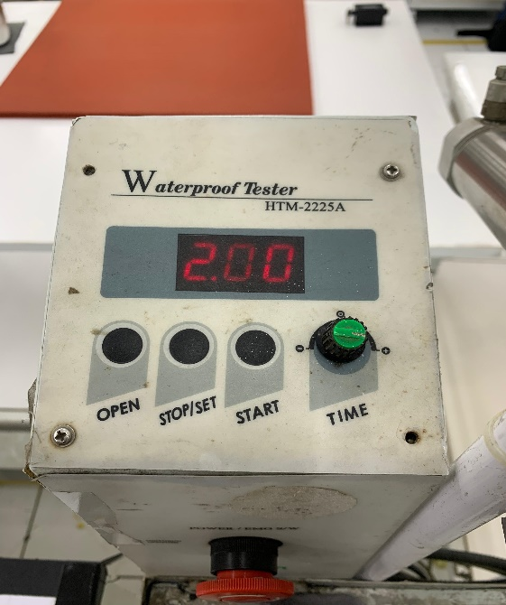
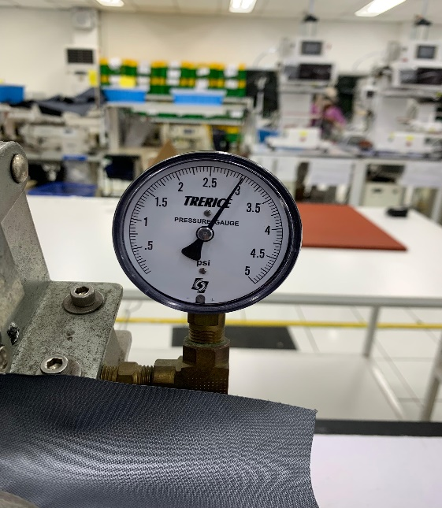
Waterproof Test Machine ( Mesin Tes Air )
Time ( Waktu )
  Mechanic setting usage time 2 minutes. ( Mekanik setting waktu pemakaian 2 menit )
Pressure ( Tekanan )
  The QC waterproof test setting the water faucet for deciding 1,5 PSI or 3 PSI. ( Operator QC tes air mengatur kran air untuk menentukan 1,5 PSI atau 3 PSI )
  Filling/reducing water at least 2 times a day. ( Pengisian/penggantian air minimal 2 kali dalam sehari )
  The water for waterproof test should not in a hot condition. ( Air untuk tes air tidak boleh dalam keadaan panas )

Slide 5
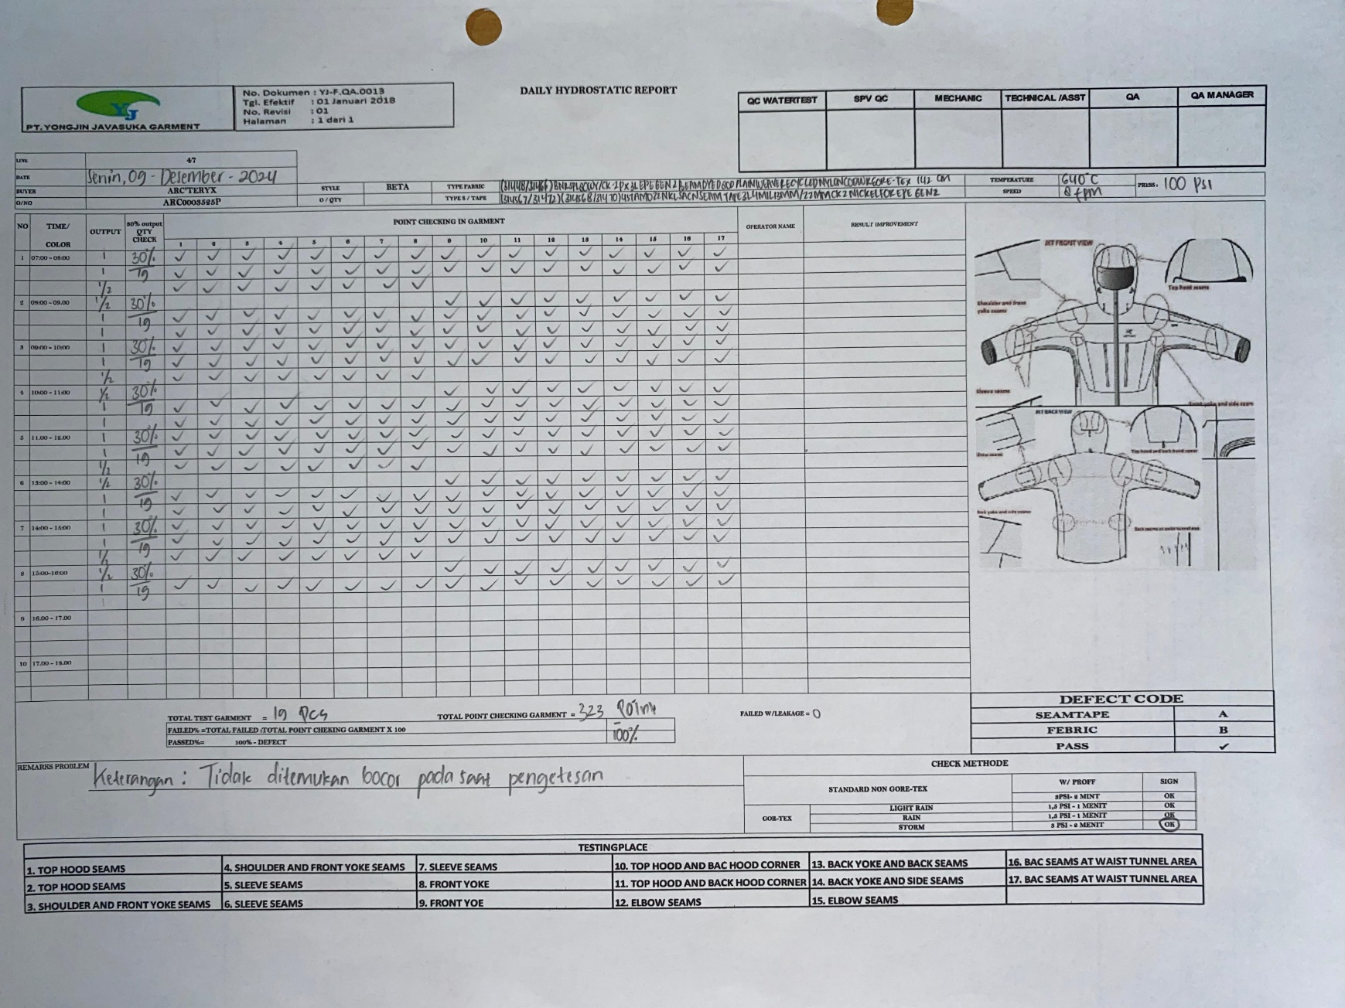
ARC’TERYX Waterproof Test Form ( Laporan Tes Air ARC’TERYX )

Slide 6
Filling in report form ARC’TERYX ( Pengisian laporan ARC’TERYX )
  Line & Date Column: Write for the Line and Date based on which Line and when the waterproof test is conducted. ( Kolom Line & Tanggal: Tulis Line dan Tanggal sesuai dengan Line mana dan kapan pelaksanaan tes air )
  Column fabric, tape, temperature, speed, nozzle: See the BOM and data in the seam sealing machine. ( Kolom fabric, tape, temperature, speed, nozzle: Lihat pada BOM dan data di mesin seam sealing )
  Column QTY Check: The waterproof test QC should count the time needed for checking 1 garment, for example, 19 points X 2 minutes = 38 minutes / PCS garment. ( Kolom 30% output cek QTY: pengetesan tes air dilakukan dari 30% output, contoh output 8 jam yaitu 64 pcs (64 x 30:100 = 19,2) jadi 19,2 pcs di bagi 8 jam kerja hasilnya 2,4 pcs perjam )

Slide 7
  Column numbers 1,2,3...etc: See the checking result while the waterproof test is conducted based on point. ( Lihat dari hasil pengecekan saat tes air berjalan sesuai point )
  - With checklist mark for non-leaking points. ( Dengan tanda ceklis untuk point yang tidak bocor )
  - with code A leaking seam tape and code B leaking fabric.( Dengan kode A bocor seam tape dan kode B bocor fabric )
  - With units of minutes and seconds for leaking points. ( Dengan satuan menit dan detik untuk point bocor )
  Column total test garment: fill with the amount of total QTY checking garment from morning until return time. ( Kolom total test garment: isi dengan jumlah total QTY checking garment dari pagi sampai jam pulang )
  Column total point checking garment: fill with the amount of points in 1 garment X total quantity checking. ( Kolom total point checking garment: isi dengan jumlah point dalam 1 garment X total quantity checking )
  Column Failed/Leakage: fill with the amount of leaking points. ( Kolom Failed/Leakage: isi dengan jumlah point yang bocor )
  Column Failed%: fill with counting ’Leak: total point checking garment X 100’. ( Kolom Fail%: isi dengan menghitung ’Bocor: total point checking garment X 100’ )
  Column passed%: fill with counting 100% - column fail% result. ( Kolom passed%: isi dengan jumlah 100% - hasil kolom fail% )

Slide 8
Checking the waterproof test report form received before the waterproof test ( Pengecekan form laporan tes air yang diterima sebelum tes air )
  See the points number in the waterproof test report ( Lihat point-point nomor di laporan tes air )
  Adjust the style number, the garment buyer to be waterproof tested with the report form that will be filled in. ( Sesuaikan nomor style, nama buyer garment yang akan dites air dengan form / laporan yang akan di isi )
  Drawings / sketches of the garment that are reported in the water test to match the point to be tested for water on the garment to be tested for water. ( Gambar / sketsa garment yang ada dilaporan tes air untuk mencocokkan point yg akan dites air pada garment yang akan dilakukan tes air )
  Then match the point on the garment to be tested by water and adjust the test point to the garment to be tested by water. ( Kemudian cocokkan point pada garment yang akan di tes air dan sesuaikan point pengetesan dengan garment yang akan di tes air )

Slide 9
Checking the waterproof test report form received before the waterproof test ( Pengecekan form laporan tes air yang diterima sebelum tes air )
  Points in the waterproof test are in text form ( point yang di tes air dalam bentuk tulisan )
  Straight : ( Lurus )
  Curve : ( Lengkung ) ( hood, armhole/raglan )
  2-way cross : 2 times seam sealing process, example neck, armhole with joint sleeve ( 2X jalan dalam proses seamsealing, contoh neck, armhole dengan joint tangan )
  3-way cross : 3 times seam sealing process, example armpit, crocth, back yoke ( 3X jalan dalam proses seamsealing, contoh armpit, crocth, back yoke )
  Fabric : Waterproof test is just for fabric not for the seam ( Tes air dilakukan hanya di fabric/bukan pada seam )

Slide 10
The Waterproof Test QC Noted Output Hour ( QC Tes Air Mencatat Output Cross Ba Per Jam )
  QC water test take garment to be water tested with hourly output. ( QC tes air mengambil garment yang akan di tes air dengan output per jam )
  The water test QC / cross op operator must record the total quantity of the cross test results ba/hour, to make it easier for the water test QC to take the number of garments that will be recalled when a leak occurs. ( QC tes air / operator cross ba harus mencatat total quantity hasil target cross ba/jam, untuk memudahkan QC tes air dalam pengambilan jumlah garment yang akan recall ketika bocor terjadi )

Slide 11
Steps To Do By The Waterproof Test QC If There Is Leaking ( Langkah – Langkah Yang Harus Dilakukan Oleh QC Tes Air Bila Terjadi Bocor )
  The waterproof test QC write the code defect, time in minutes / seconds when leaking happens in waterproof test report form. ( QC tes air menulis kode defect menit/detik waktu terjadi bocor di form / laporan tes air )
  The waterproof test QC continue the test until the last point in garment, finish 1 garment. ( QC tes air melanjutkan tes air sampai point terakhir pada point garment, selesai 1 garment )
  If a leak is found during testing, QC water testing must conduct a recall (collecting all garment output results at that time/according to the color of the raffia cord being tested) to conduct testing on the leaking point.( Jika kebocoran ditemukan pada saat pengetesan, maka QC tes air harus melakukan penarikan kembali / recall (mengambil semua hasil output garment dijam tersebut / sesuai warna tali rapia yang sedang dites) untuk dilakukan pengetesan pada point yang bocor )
  After the water test qc recall continues to the next output. ( Setelah dilakukan recall qc tes air melanjutkan pengetesan ke output berikutnya )

Slide 12
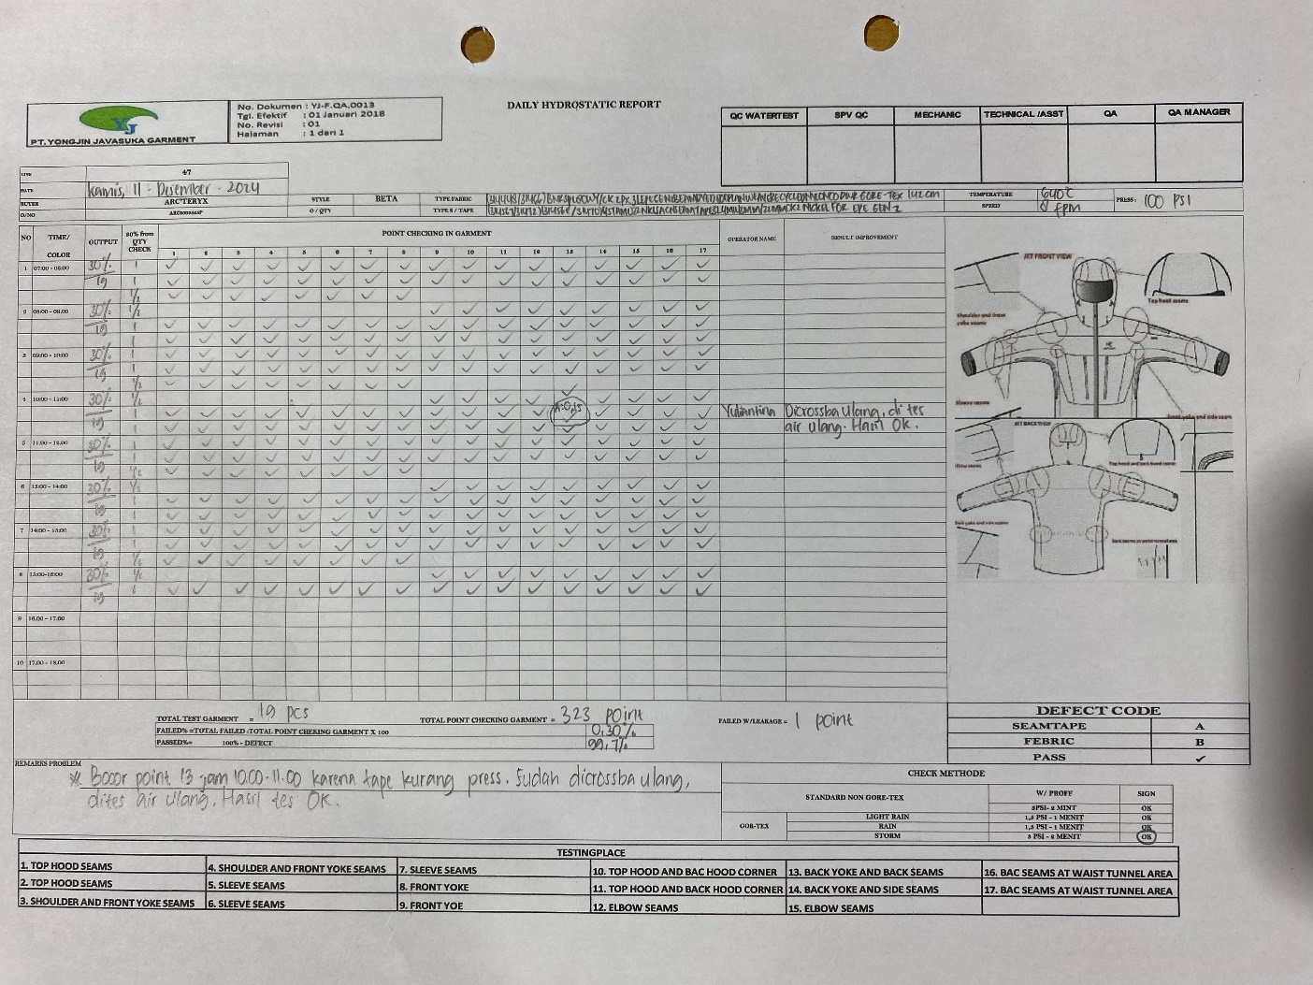
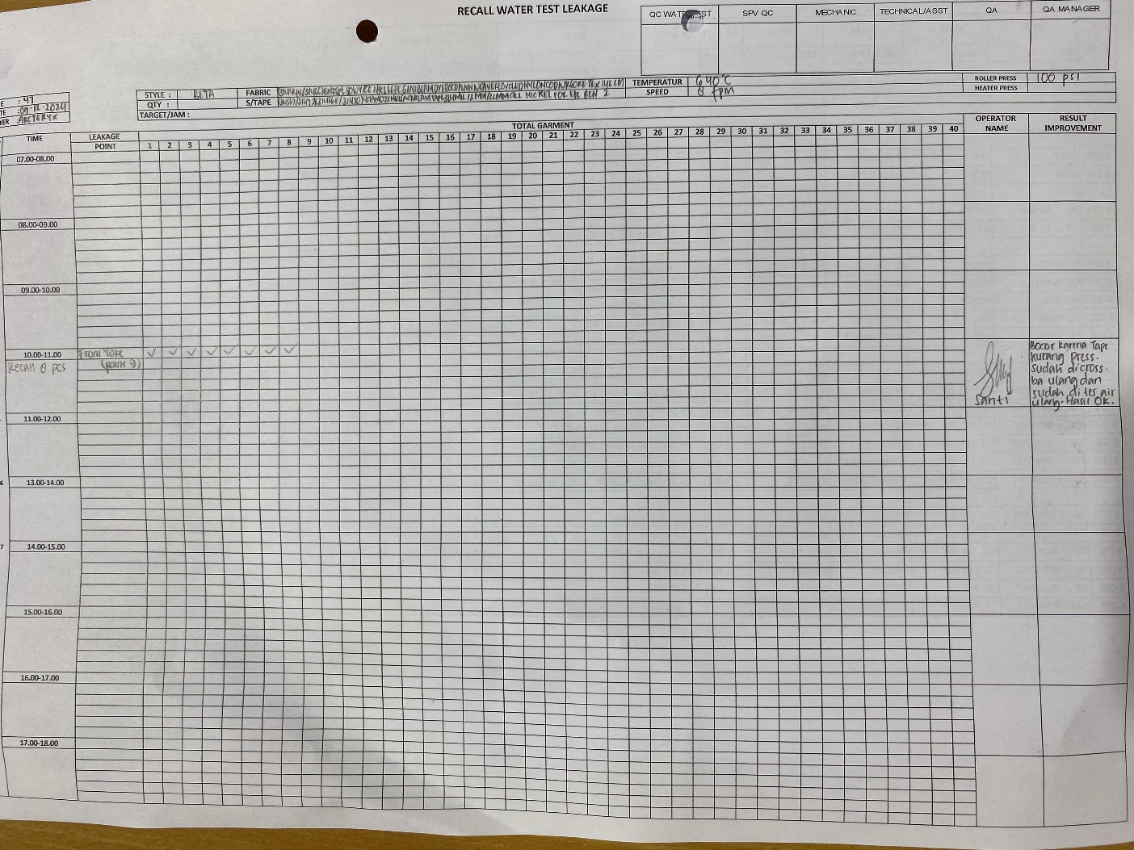
How to Fill Out the Recall Report If Leaking Happened ( Cara Pengisian laporan Recall Bila Terjadi Bocor )
  Cara penulisan recall

Slide 13
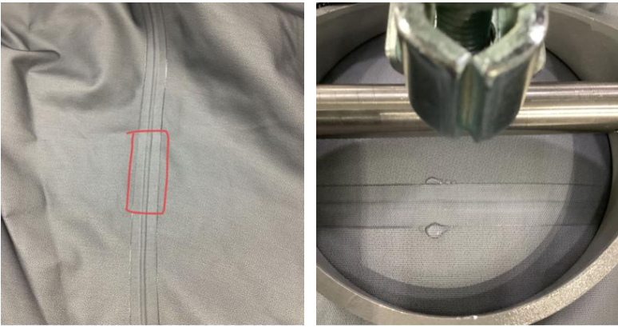
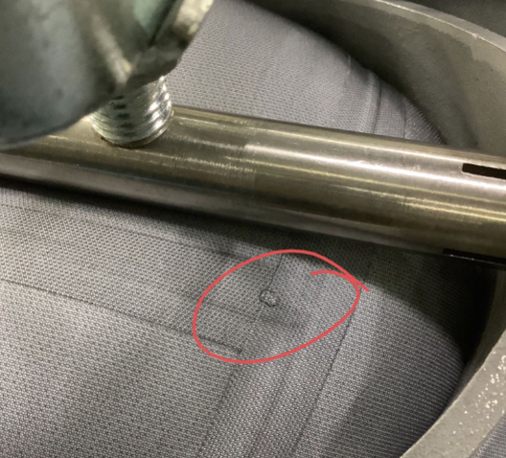
Kinds of Leakage ( Jenis – Jenis Bocor )
Fail Sutter test

Slide 14
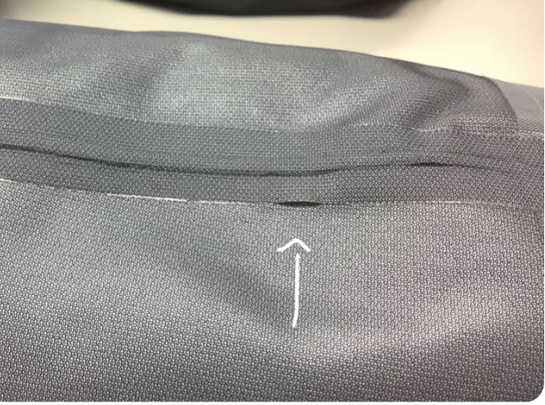
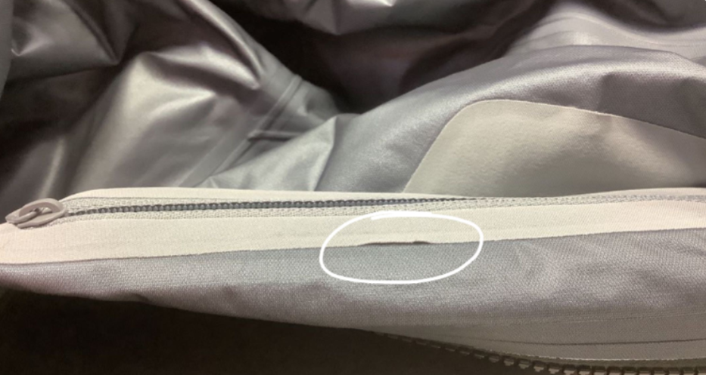
Open Lamination

Slide 15
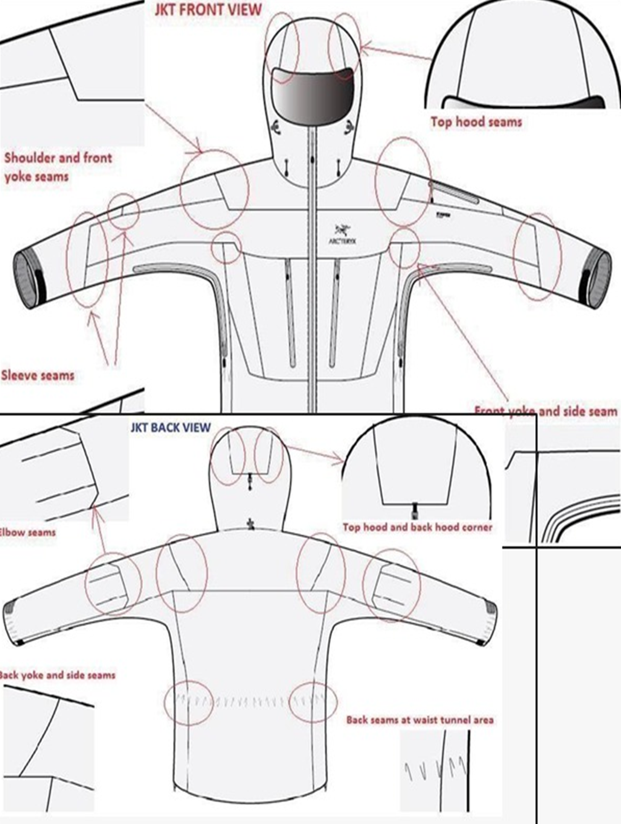
Name of Body Parts in Garment For Waterproof Test ( Nama – Nama Bagian Body Untuk Tes Air )
  Nama bagian tes air
  Top hood seam
  Top hood seam
  Shoulder and front yoke seams
  Shoulder and front yoke seams
  Sleeve seams
  Sleeve seams
  Sleeve seams
  Front yoke
  Front yoke
  Top hood and back hood corner
  Top hood and back hood corner
  Elbow seams
  Back yoke and back seams
  Back yoke and side seams
  Elbow seams
  Back seams at waist tunnel area
  Back seams at waist tunnel area

